Slide 1
Graphs
Graphs are used to represent the competition of different species in an ecological niche, graphs are also used to represent who influences whom in an organization, and graphs are used to represent the outcomes of round tournaments.
We will learn how graphs can be used to model acquaintanceships between people, the collaboration between researchers, telephone calls between telephone numbers, and links between websites and how graphs can be used to model roadmaps and the assignment of jobs to employees of an organization.

Slide 3
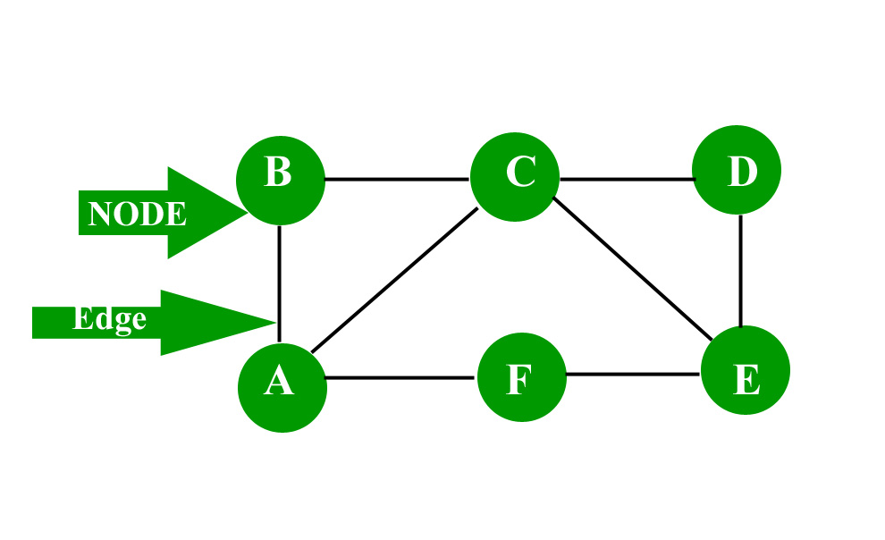
A graph is a data structure that is defined by two components :
A node or a vertex.
An edge E or ordered pair is a connection between two nodes u,v that is identified by unique pair (u,v). The pair (u,v) is ordered because (u,v) is not the same as (v,u) in the case of the directed graph. The edge may have a weight or is set to one in case of unweighted graph.

Slide 4
Applications: The graph is a data structure that is used extensively in real-life.
Social Network: Each user is represented as a node and all their activities, suggestion and friend list are represented as an edge between the nodes.
Google Maps: Various locations are represented as vertices or nodes and the roads are represented as edges and graph theory is used to find the shortest path between two nodes.
Recommendations on e-commerce websites: The “Recommendations for you” section on various e-commerce websites uses graph theory to recommend items of a similar type to the user’s choice.
Graph theory is also used to study molecules in chemistry and physics.

Slide 5


The concept of graphs in graph theory stands up on some basic terms such as point, line, vertex, edge, degree of vertices, properties of graphs, etc. we will cover the fundamentals of graph theory.
Point: A point is a particular position in a one-dimensional, two-dimensional, or three-dimensional space. For better understanding, a point can be denoted by an alphabet. It can be represented with a dot.
2. Line: A Line is a connection between two points. It can be represented with a solid line.

Slide 6
3. Vertex: A vertex is a point where multiple lines meet. It is also called a node. Similar to points, a vertex is also denoted by an alphabet.
4. Edge: An edge is a mathematical term for a line that connects two vertices. Many edges can be formed from a single vertex. Without a vertex, an edge cannot be formed. There must be a starting vertex and an ending vertex for an edge.

Slide 7
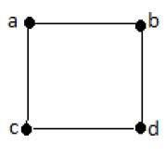
Graph: A graph ‘G’ is defined as G = (V, E) Where V is a set of all vertices and E is a set of all edges in the graph.
In the above example, ab, ac, cd, and bd are the edges of the graph. Similarly, a, b, c, and d are the vertices of the graph.

Slide 8
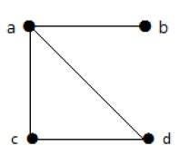

In this graph, there are four vertices a, b, c, and d, and four edges ab, ac, ad, and cd.
Loop: In a graph, if an edge is drawn from the vertex to itself, it is called a loop.

Slide 9
Adjacent node: A node ‘v’ is said to be the adjacent node of node ‘u’ if and only if there exists an edge between ‘u’ and ‘v’.
Adjacency
Here are the norms of adjacency −
In a graph, two vertices are said to be adjacent, if there is an edge between the two vertices. Here, the adjacency of vertices is maintained by the single edge that is connecting those two vertices.
In a graph, two edges are said to be adjacent, if there is a common vertex between the two edges. Here, the adjacency of edges is maintained by the single vertex that is connecting two edges.

Slide 10
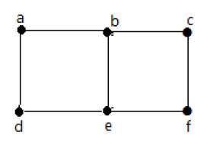
In the above graph −
‘a’ and ‘b’ are the adjacent vertices, as there is a common edge ‘ab’ between them.
‘a’ and ‘d’ are the adjacent vertices, as there is a common edge ‘ad’ between them.
ab’ and ‘be’ are the adjacent edges, as there is a common vertex ‘b’ between them.
be’ and ‘de’ are the adjacent edges, as there is a common vertex ‘e’ between them.

Slide 11
Degree of Vertex: It is the number of vertices adjacent to a vertex V.
Notation − deg(V).
In a simple graph with n number of vertices, the degree of any vertices is −
deg(v) ≤ n – 1 ∀ v ∈ G
A vertex can form an edge with all other vertices except by itself. So the degree of a vertex will be up to the number of vertices in the graph minus 1. This 1 is for the self-vertex as it cannot form a loop by itself. If there is a loop at any of the vertices, then it is not a Simple Graph.
Degree of a vertex can be considered under two cases of graphs −
Undirected Graph
Directed Graph

Slide 12
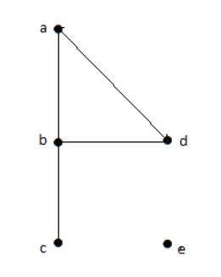
Degree of Vertex in an Undirected Graph: An undirected graph has no directed edges.
In Undirected Graph,
deg(a) = 2, as there are 2 edges meeting at vertex ‘a’.
deg(b) = 3, as there are 3 edges meeting at vertex ‘b’.
deg(c) = 1, as there is 1 edge formed at vertex ‘c’
So ‘c’ is a pendent vertex.
deg(d) = 2, as there are 2 edges meeting at vertex ‘d’.
deg(e) = 0, as there are 0 edges formed at vertex ‘e’.
So ‘e’ is an isolated vertex.

Slide 13
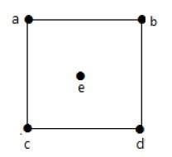

Slide 14
Degree of Vertex in a Directed Graph:
In a directed graph, each vertex has an in-degree and an outdegree.
Indegree of a Graph
Indegree of vertex V is the number of edges that are coming into the vertex V.
Notation − deg−(V).
Outdegree of a Graph
Outdegree of vertex V is the number of edges that are going out from the vertex V.
Notation − deg+(V).
Note that a loop at a vertex contributes 1 to both the in-degree and the out-degree of this vertex.

Slide 15
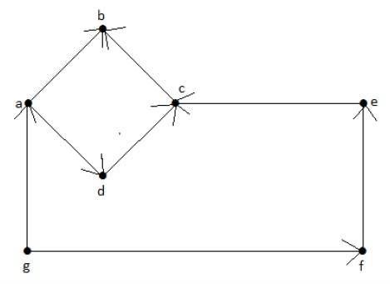
Vertex ‘a’ has two edges, ‘ad’ and ‘ab’, which are going outwards. Hence its outdegree is 2. Similarly, there is an edge ‘ga’, coming towards vertex ‘a’. Hence the indegree of ‘a’ is 1.

Slide 16
Vertex | Indegree | Outdegree
a | 1 | 2
b | 2 | 0
c | 2 | 1
d | 1 | 1
e | 1 | 1
f | 1 | 1
g | 0 | 2

Slide 17
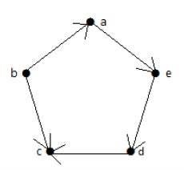

Slide 18
Vertex | Indegree | Outdegree
a | 1 | 1
b | 0 | 2
c | 2 | 0
d | 1 | 1
e | 1 | 1

Slide 19

Pendant Vertex
A vertex with degree one is called a pendent vertex.
Here, in this example, vertex ‘a’ and vertex ‘b’ have a connected edge ‘ab’. So with respect to the vertex ‘a’, there is only one edge towards vertex ‘b’ and similarly with respect to the vertex ‘b’, there is only one edge towards vertex ‘a’. Finally, vertex ‘a’ and vertex ‘b’ has degree as one which are also called as the pendent vertex.
Isolated Vertex
A vertex with degree zero is called an isolated vertex.

Slide 20

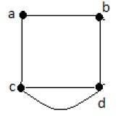
Parallel Edges
In a graph, if a pair of vertices is connected by more than one edge, then those edges are called parallel edges.
Multi Graph
A graph having parallel edges is known as a Multigraph.

Slide 22

Handshaking Theorem :
What would one get if the degrees of all the vertices of a graph are added? In the case of an undirected graph, each edge contributes twice, once for its initial vertex and the second for its terminal vertex. So the sum of degrees is equal to twice the number of edges. This fact is stated in the Handshaking Theorem.

Slide 24
Underlying undirected graph: The undirected graph that results from ignoring the directions of edges is called the underlying undirected graph. A graph
with directed edges and its underlying undirected graph having the same number of edges.

Slide 25
Some Special Simple Graphs
Complete Graphs
Cycles
Wheels
n-Cubes

Slide 26
Complete Graphs A complete graph on n vertices, denoted by Kn, is a simple graph that contains exactly one edge between each pair of distinct vertices. The graphs Kn, for n = 1, 2, 3, 4, 5, 6, are displayed in the following figure. A simple graph for which there is at least one pair of distinct vertex not connected by an edge is called noncomplete.

Slide 27
Cycles: A cycle Cn, n ≥ 3, consists of n vertices v1, v2, . . . , vn and edges {v1, v2},
{v2, v3}, . . . , {vn−1, vn}, and {vn, v1}. The cycles C3, C4, C5, and C6 are displayed

Slide 28
Wheels: We obtain a wheel Wn when we add an additional vertex to a cycle Cn, for n ≥ 3, and connect this new vertex to each of the n vertices in Cn, by new edges. The wheels W3, W4, W5, and W6 are displayed

Slide 29
Bipartite Graphs: Sometimes a graph has the property that its vertex set can be divided into two disjoint subsets such that each edge connects a vertex in one of these subsets to a vertex in the other subset.
A simple graph G is called bipartite if its vertex set V can be partitioned into two disjoint sets V1 and V2 such that every edge in the graph connects a vertex in V1 and a vertex in V2 (so that no edge in G connects either two vertices in V1 or two vertices in V2). When this condition holds, we call the pair (V1, V2) a bipartition of the vertex set V of G.

Slide 30
Complete Bipartite Graphs A complete bipartite graph Km,n is a graph that has its vertex set partitioned into two subsets of m and n vertices, respectively with an edge between two vertices if and only if one vertex is in the first subset and the other vertex is in the second subset.
The complete bipartite graphs K2,3, K3,3, K3,5, and K2,6 are displayed

Slide 31
Draw these graphs.
a) K7 b) K1,8 c) K4,4 d) C7 e) W7
(a) K7: This graph has 7 vertices, with an edge joining each pair of distinct vertices.

Slide 32
b) K1,8 : This graph is the complete bipartite graph on parts of size 1 and 8; we have put the part of size 1 in the middle.
c) This is the complete bipartite graph with 4 vertices in each part.

Slide 33
d) This is the 7-cycle.
e) The 7-wheel is the 7-cycle with an extra vertex joined to the other 7 vertices.

Slide 34
New Graphs from Old
Sometimes we need only part of a graph to solve a problem. When edges
and vertices are removed from a graph, without removing endpoints of any remaining edges, a smaller graph is obtained. Such a graph is called a subgraph of the original graph.

Slide 36
GRAPH UNIONS: Two or more graphs can be combined in various ways. The new graph that contains all the vertices and edges of these graphs is called the union of the graphs. We will give a more formal definition for the union of two simple graphs.
The union of two simple graphs G1 = (V1,E1) and G2 = (V2,E2) is the simple graph with vertex set V1 ∪ V2 and edge set E1 ∪ E2. The union of G1 and G2 is denoted by G1 ∪ G2.

Slide 37
Find union of following graphs:

